Slide 1
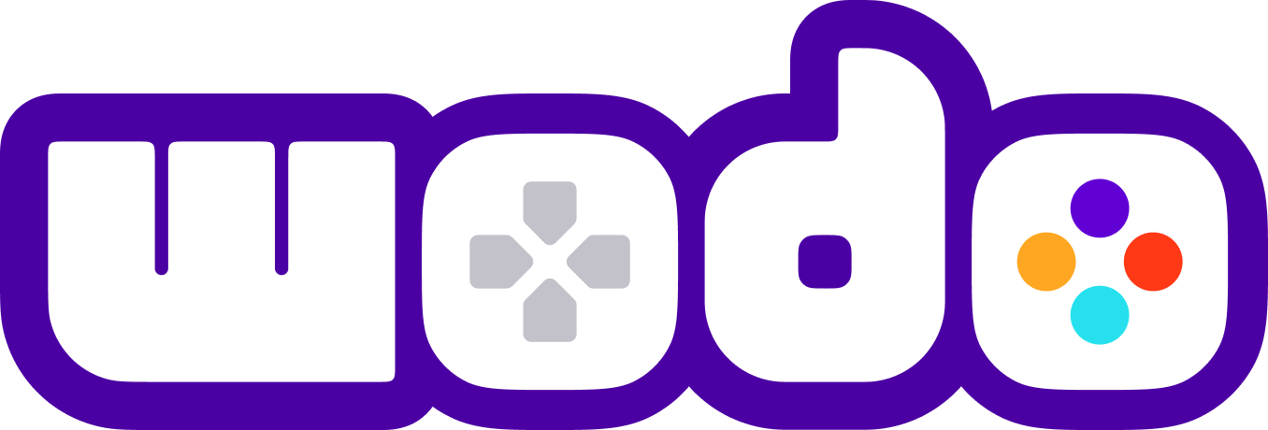
WODO
Blockchain, NFT, Metaverse, Gaming
PLATFORM
WODO
2022
Your gateway to Blockchain, NFT and Metaverse technologies
© 2022. All Rights Reserved

Slide 2
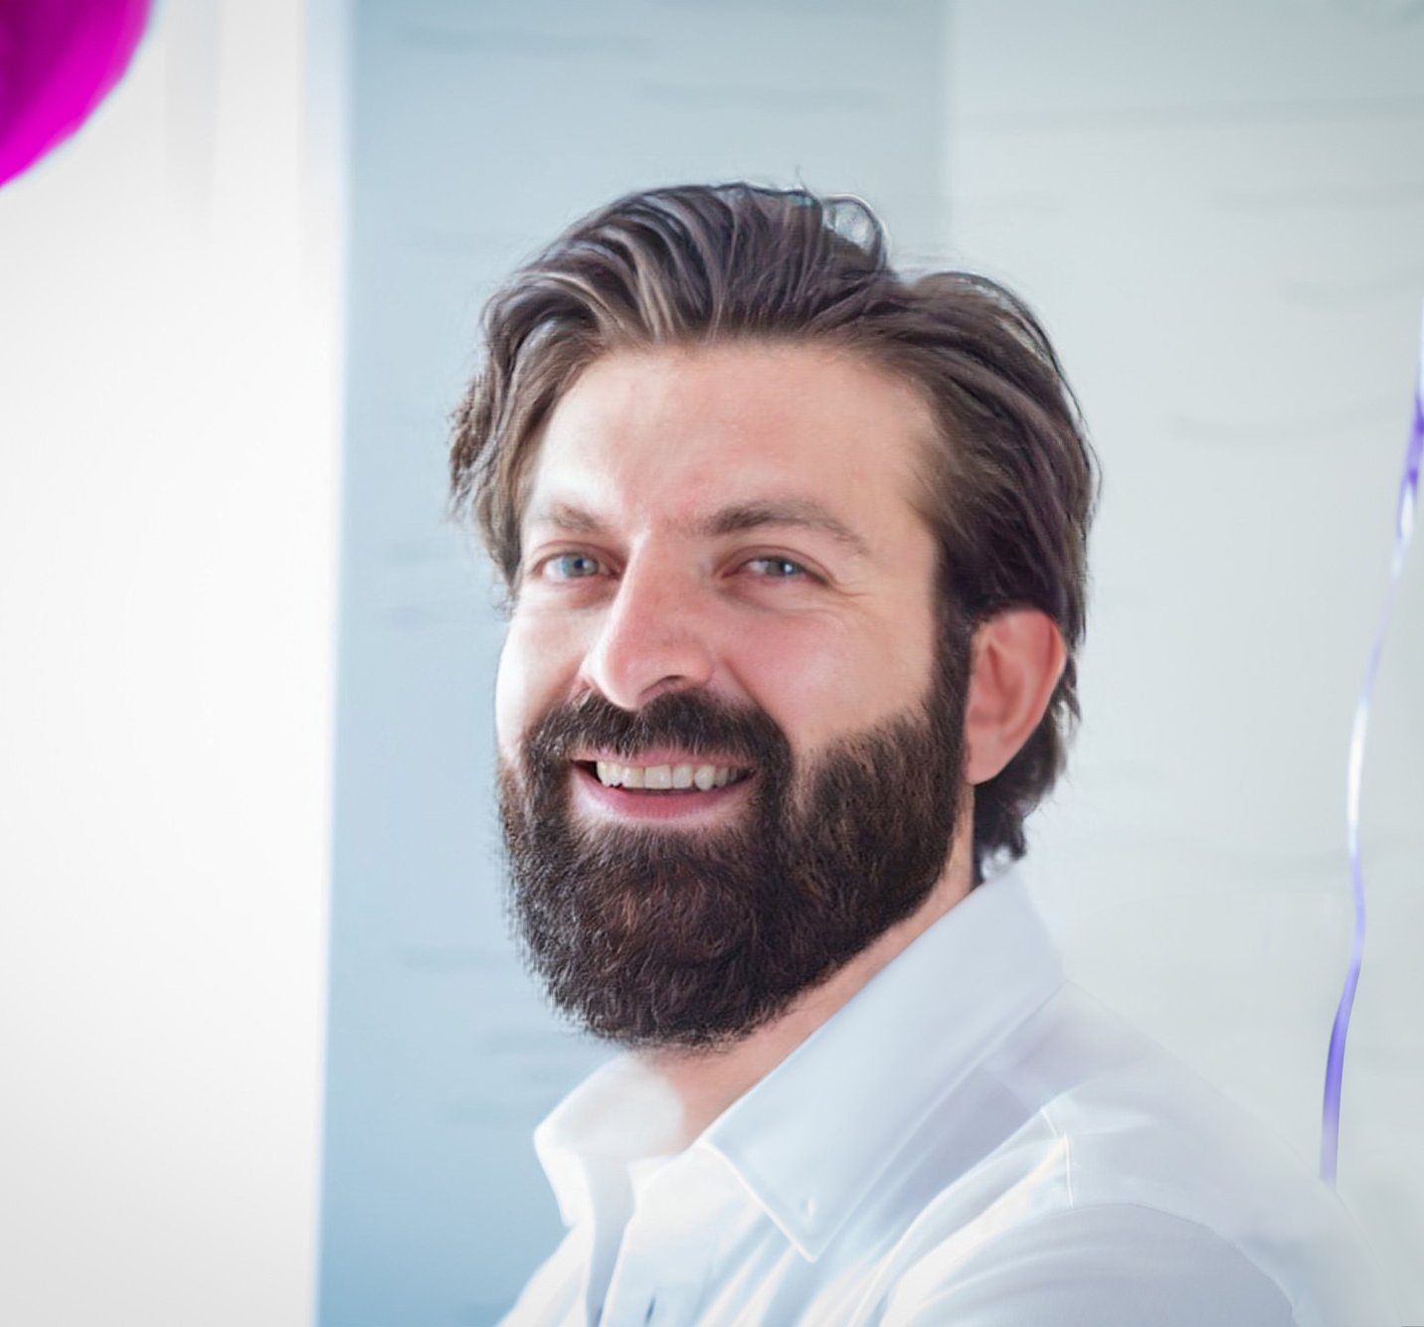
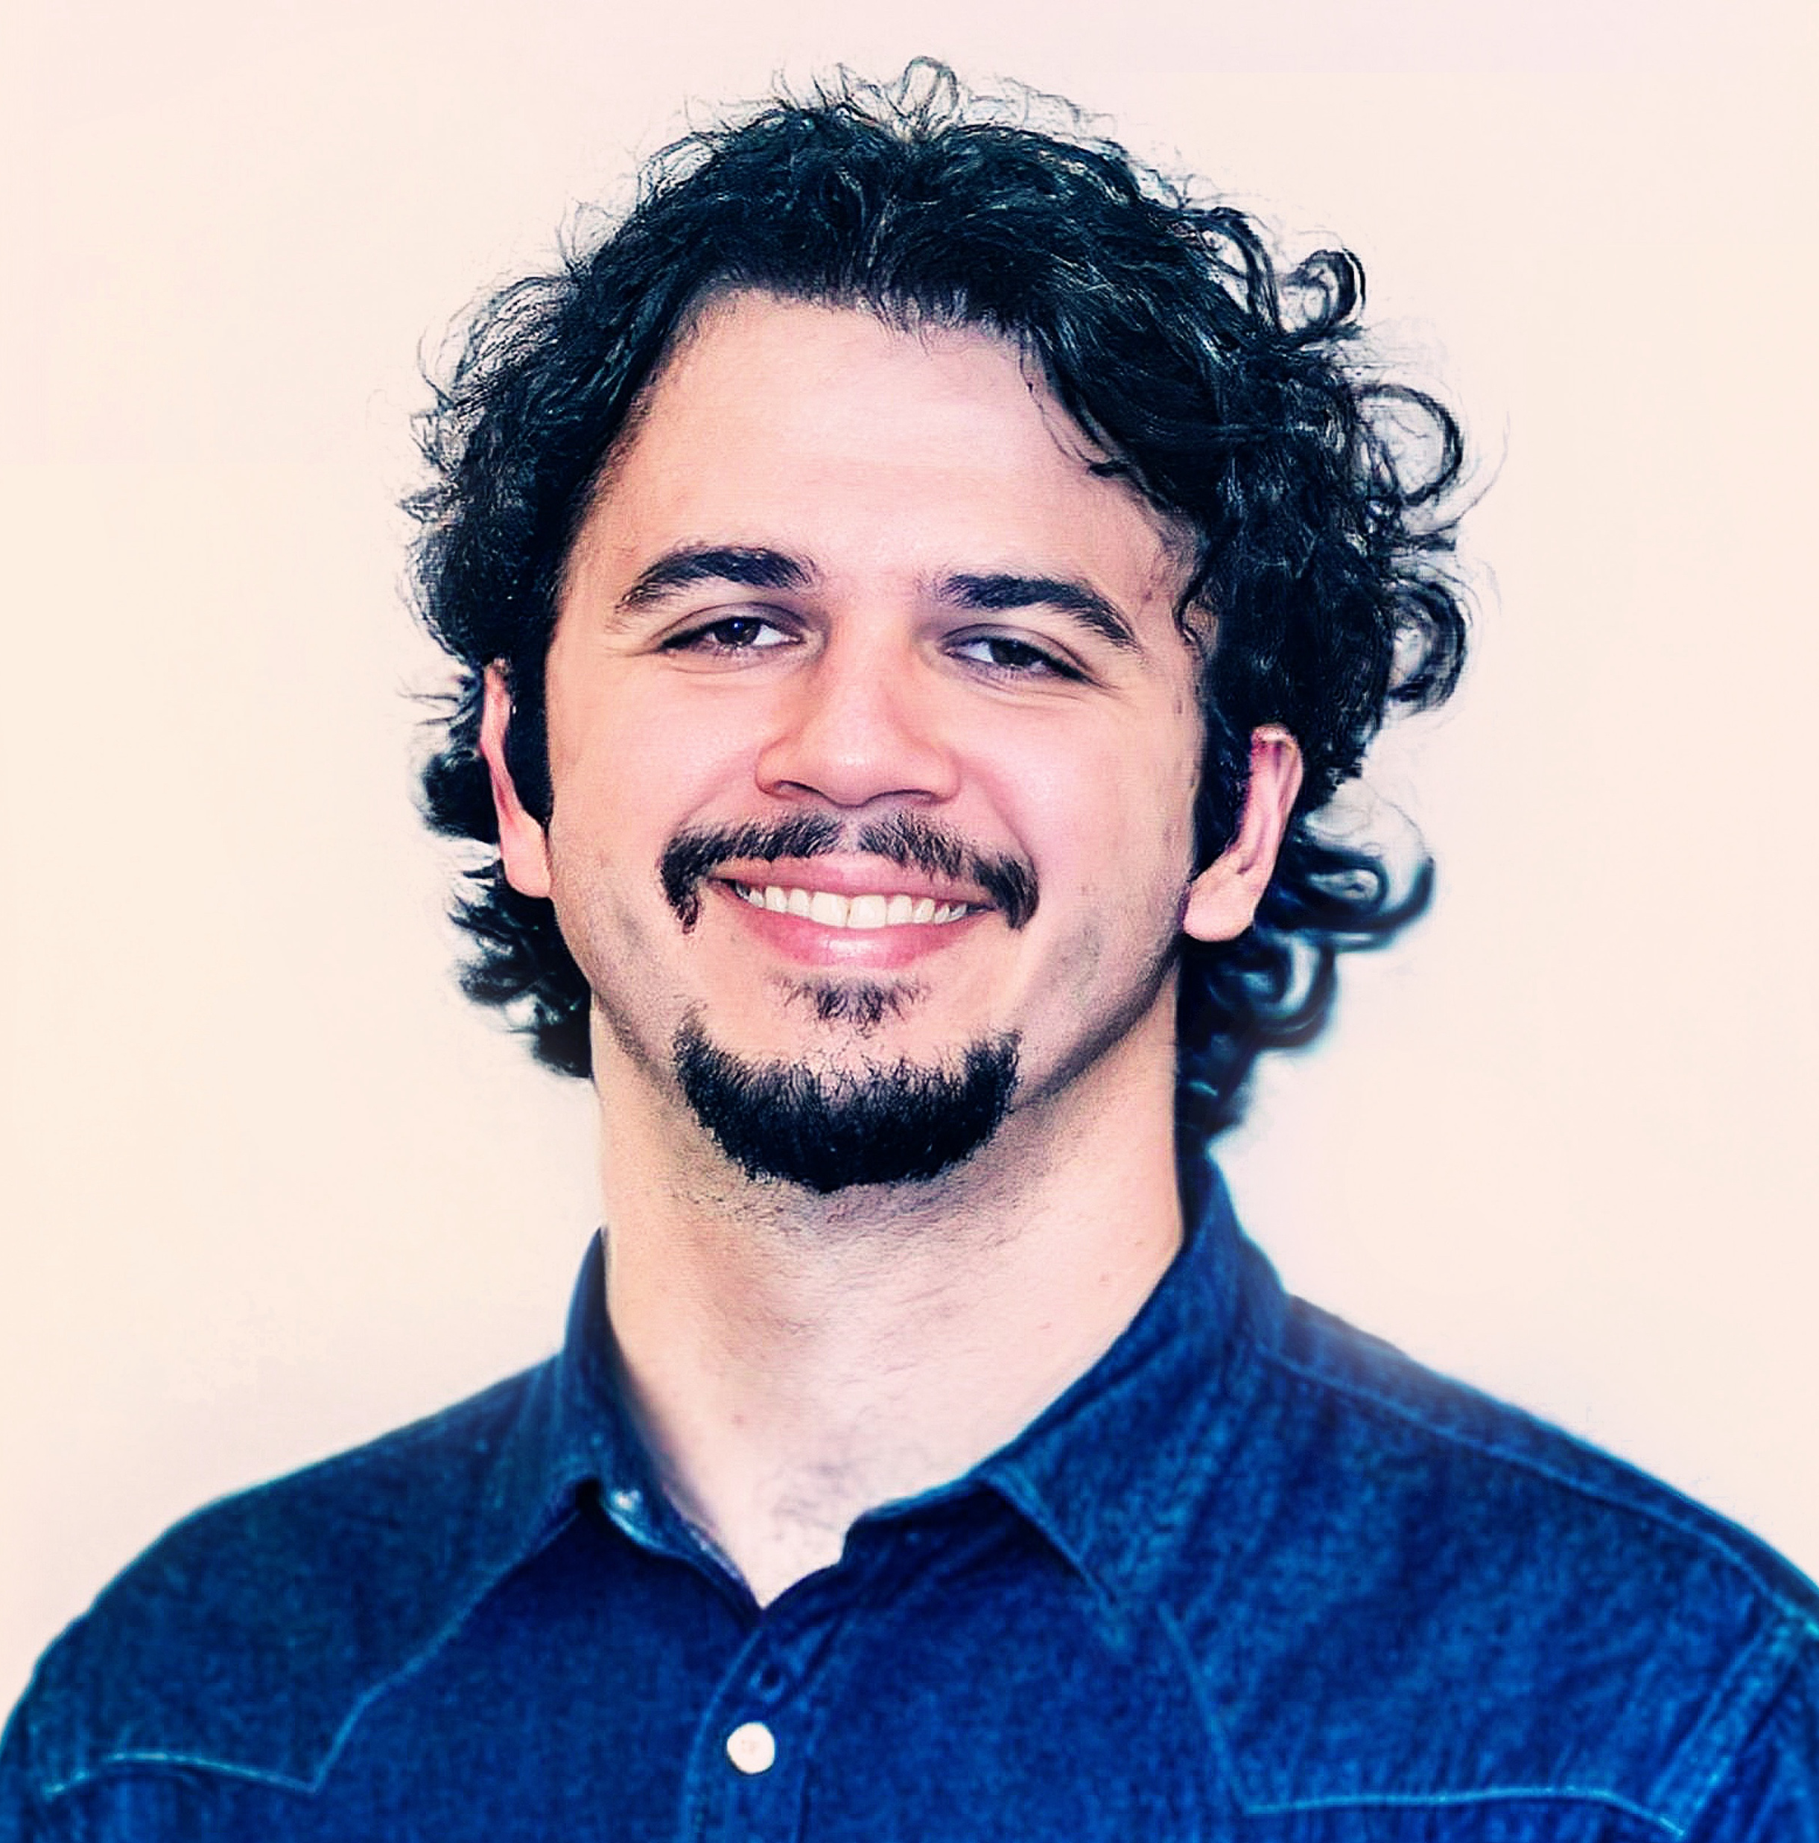

Founders
Bekir Dag
Serhat TANRIKUT
CEO
CTO
19 years of experience in Software Development
Delivered tens of different projects of various sizes in different industries
Started his own web-shop in 2011
Worked for the biggest advertisement agencies in Turkey and built enterprise products such as playstore.com, IKSV.org and secretcv.com
Managed development teams of 10+ people in 3 different software companies in North America and created the standards for support lifecycle. Created tens of different projects from the idea stage to the end product.
Partnered with Student Ally and built the software from scratch with his team, which has a complicated structure and lives on the cloud.
Vast experience in product creation and product life cycle
Founded Wodo Networks as CEO
17 years of experience in Software Development
Walked through many different roles (software engineer, tech team lead, scrum master, release manager, R&D Leader, People Manager)
7 years of leadership experience in Nokia (built international teams, delivered high performant, distributed telco products )
Built/Led market leader device manager/IoT platform for the telecommunication industry in Nokia. 200+ deployments all around the world.
Led SaaS-Cloud Infrastructure Team in Sitecore
Founded Wodo Networks as CTO
Vast experience in leadership, software product development, software architecture, and cloud technologies.
Notes:
Bekir and Serhat met 13 years ago, both have engineering background.

Slide 3
Our vision is to accelerate the transformation of the gaming ecosystem to a new era built around Blockchain and Metaverse technologies and to establish a community as a reference point through curating simple, practical, innovative solutions .
Wodo Gaming
Notes:
Wodo Network is Web 3.0 technology company. We want to focus on the gaming industry first since our vision is broad and significant.
Start to talk about Wodo Platform, how we prioritize our vision and solutions then jump to the next slide

Slide 4

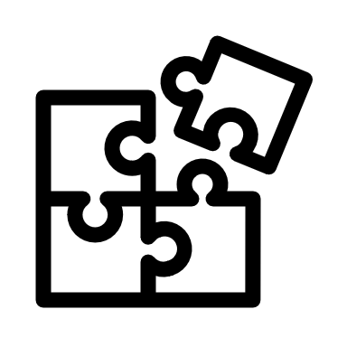
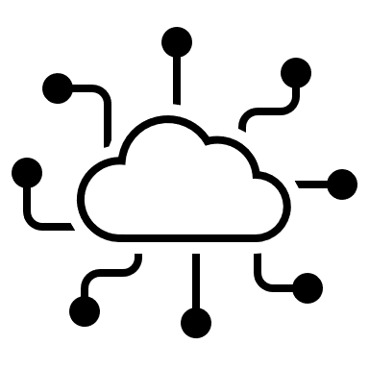
Wodoland
The first blockchain & NFT enabled Mmorpg game leveraging the wodo platform services and gaming solutions.
Play to earn and collect. Demo: https://www.youtube.com/watch?v=QpTORoBwLIs
Solutions
Wodo Gaming
Game Hub, Marketplace, Launchpad, Wallet solutions and development kits to adopt blockchain technologies at speed in gaming industry. It is built upon the wodo platform Demo: https://www.youtube.com/watch?v=XlI5Tey1g5M
Wodo Platform
Multitenant, secure, scalable and intelligent platform with blockchain, NFT and metaverse integration services.
Intro: https://www.youtube.com/watch?v=339_rUo_H0U

Slide 5
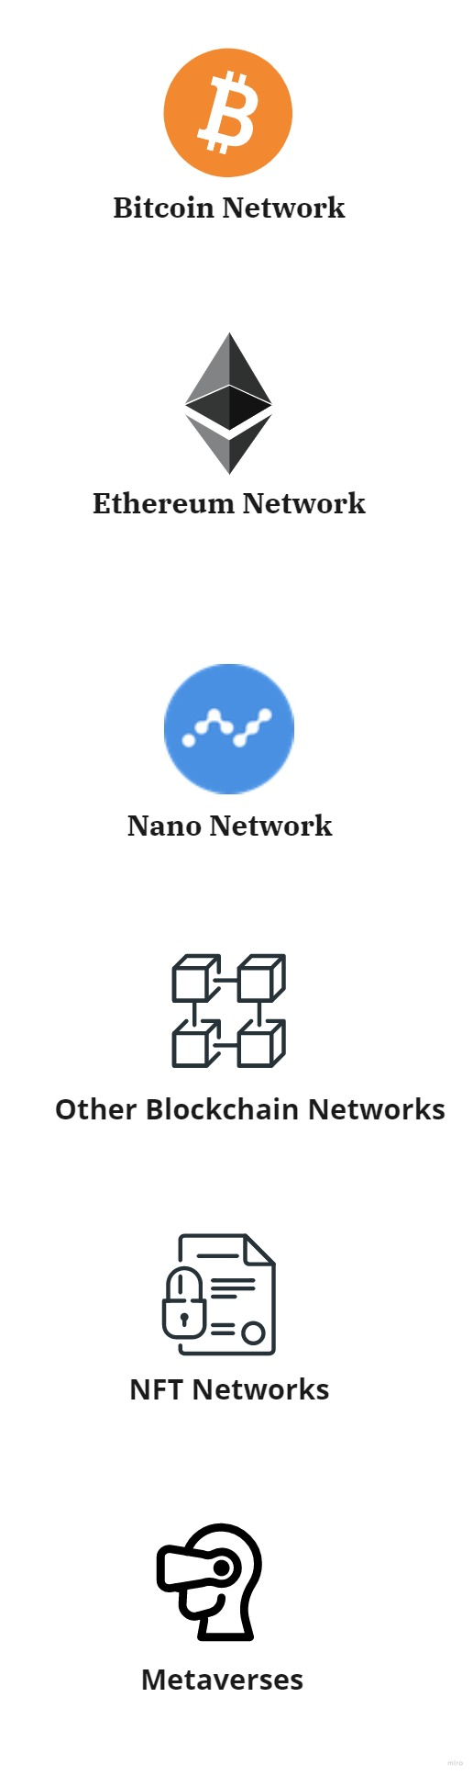
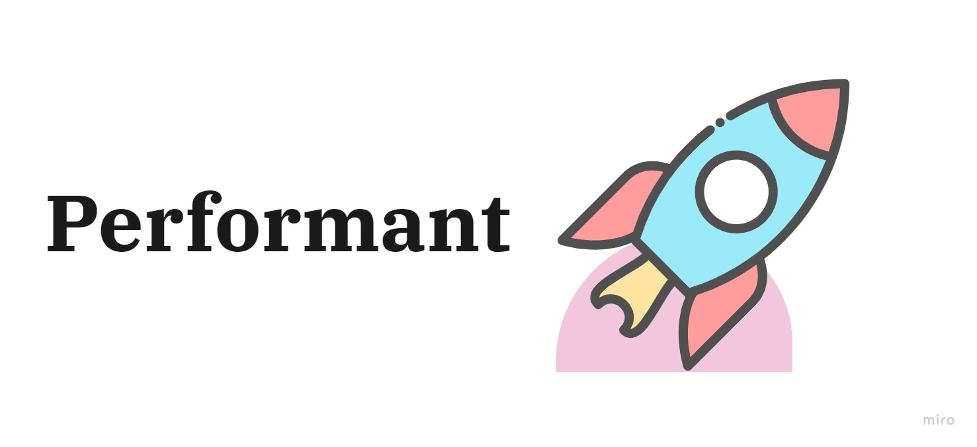
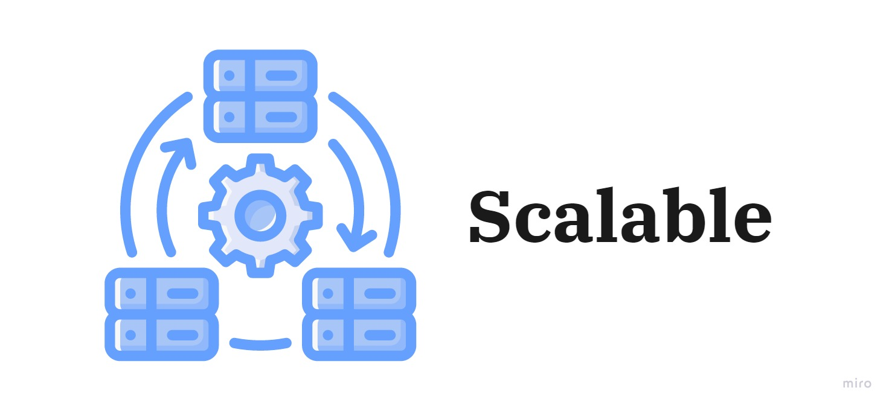
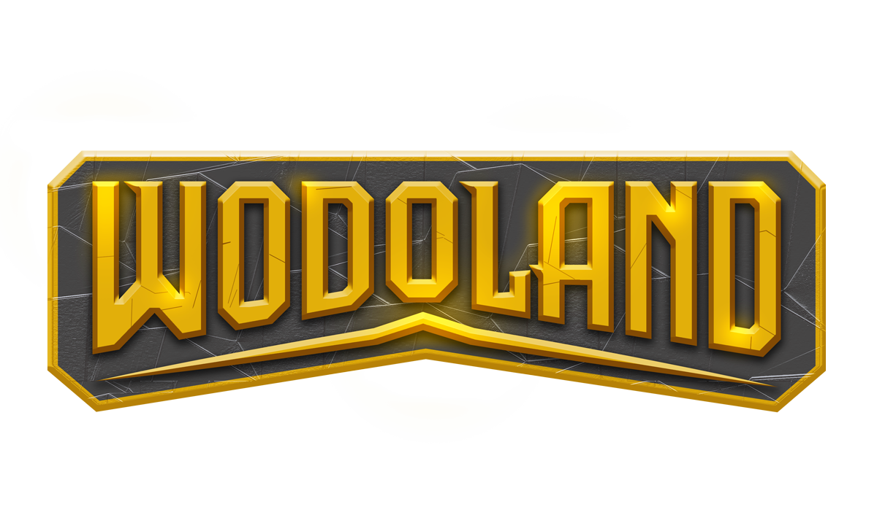


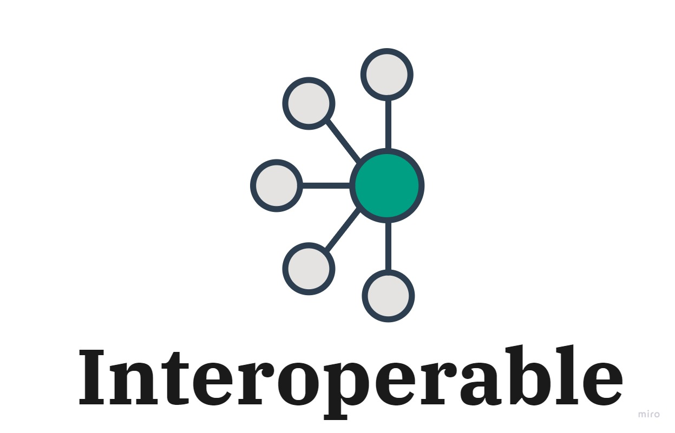
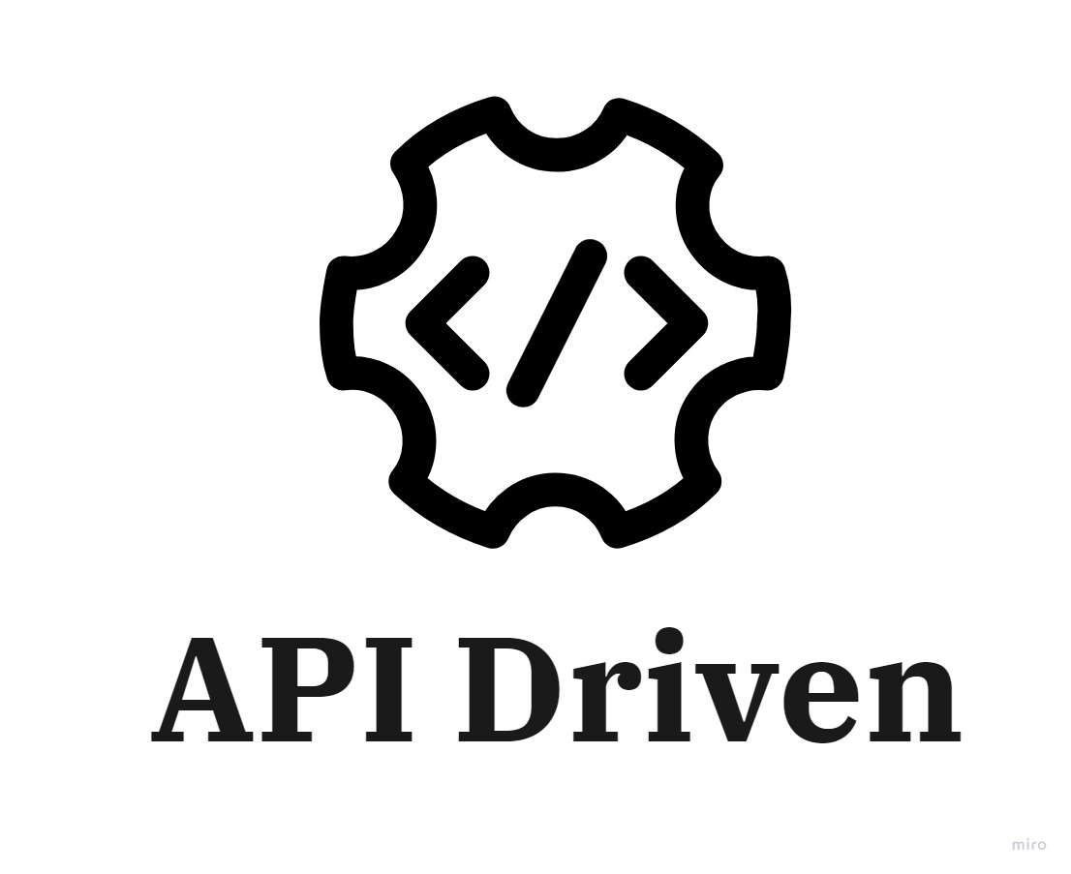
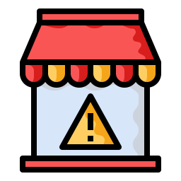


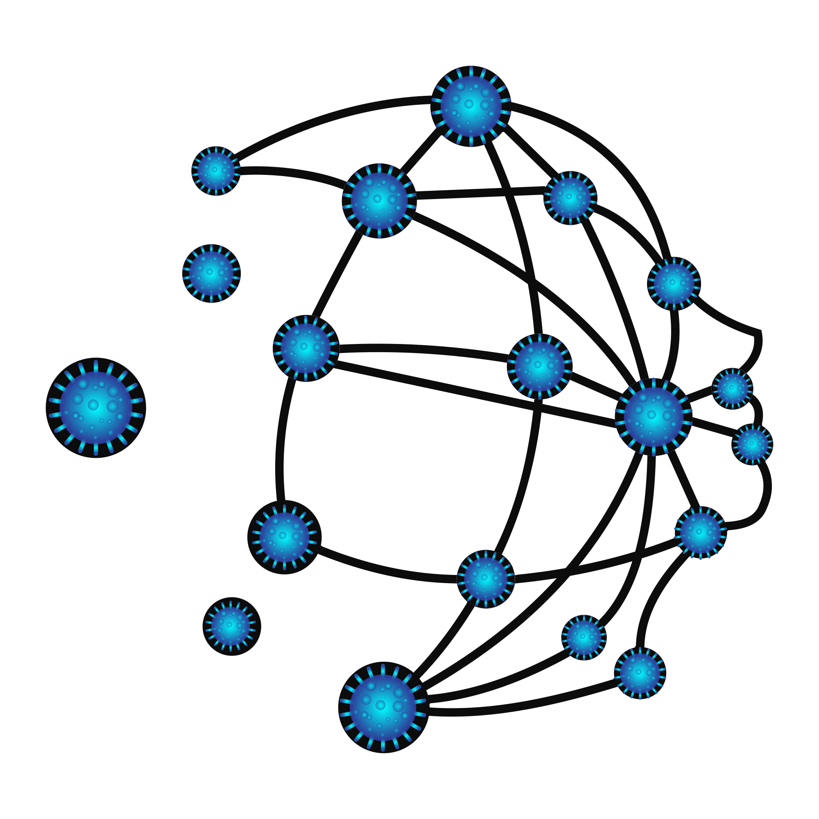

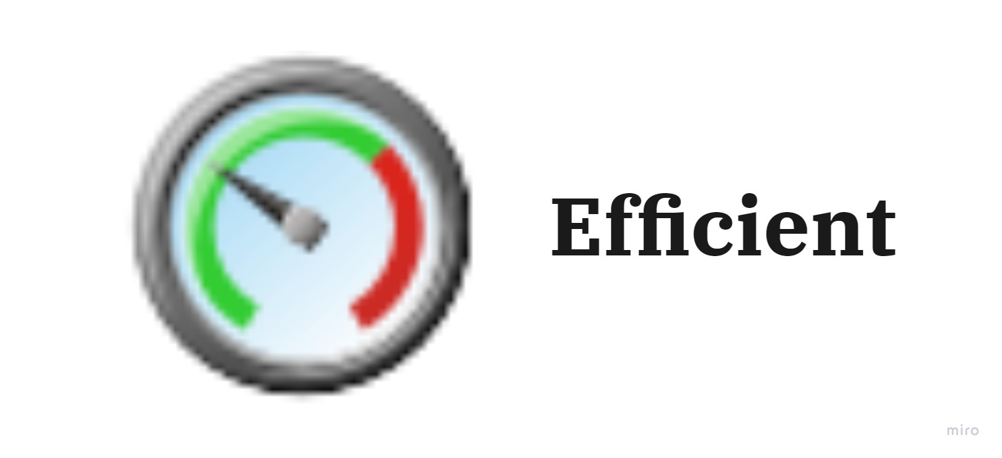
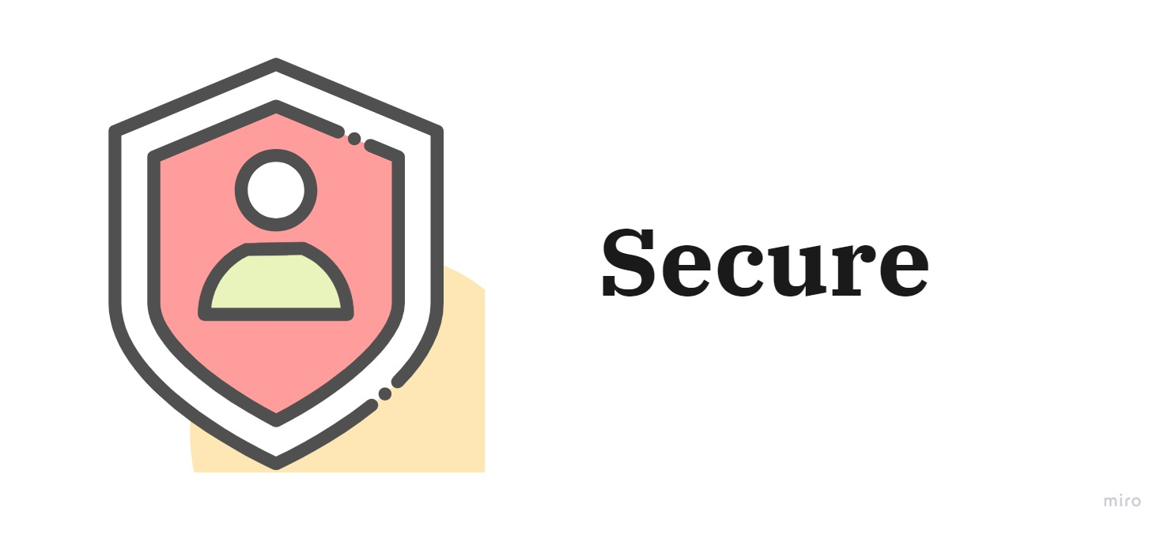
- Solutions
Game Hub
SDKs
Game Store
Launchpad
MMORPG
Fully Integrated with our solutions/APIS
In-Game marketplace
Game Hosting
Marketplace
Wodo Platform
Wodo Gaming
Wodoland Game
Notes:
1- Wodo Platfom: Fundamental pillar of our vision and solutions. Multi-tenant, cloud based, interoperable
2- Wodo Gaming solutions run on the platform
3- Wodoland
Talk about SDKs and Wodo Academy

Slide 6

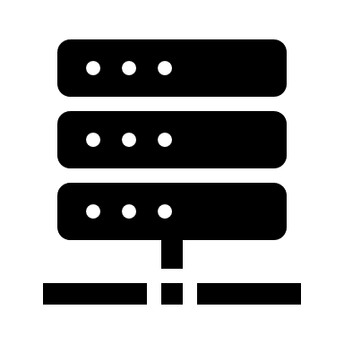





Game Hub/Store
Marketplace
Integration
Beta testing,
Controlled testing,
feedback loops, tunings
Game Hosting
Optional: Low latency, high performance hosting environment
Crowd Funding
Tokenomics,
Launchpad partnerships
Launch
Wodo Gaming
Going live, “zero touch” user registration into Games via Game Hub, active community support, tournaments
Ecosystem
Funding via partnered Launchpads
Built for builders by builders
Development
Idea, Wodo SDK, client libraries,
in-game economics,
Analytics
Live data, statistics for in-game economics, Game Hub, Marketplace, Game Store. Tuning algorithms-AI
Notes:
Wodo Gaming handles end-2-end, full lifecycle of a gaming project by leveraging SDKs and platform APIs, and gaming solutions
1- Based on game type and idea, we offer best in-game economic model and help developers to implement blockchain, NFT and metaverse integration at ease.
2- Once the initial design is done, we offer crowdfunding and an optimum tokenomics model. We plan to establish partnerships with other launchpads to raise money. It is not our whole purpose to operate in the traditional launchpad model.
3- The gaming projects progresses, We provide a stable environment to run beta testing, controlled introduction to the wodo game hub community, feedback loops, performance testing/tunings
4- Optional game hosting for average game projects
5- Going live. Onboarding game-hub community users to the game, listing the game on Game Store, Marketplace
6- Rich insights about the game, exposing data via APIs, Game Hub data, Marketplace data, Game Store data. AI analysis and suggestions

Slide 7
Wodo Gaming
Unlimited potential
Web 3.0 is the future with a new digital economic model
Future
Wodo Platform
$ 1400 B
Implement any business use cases
Wodo platform makes it easy and painless to implement any blockchain and metaverse business use cases in agility
Economic value in the upcoming 5 years
WODO NETWORK 2022
7

Slide 8

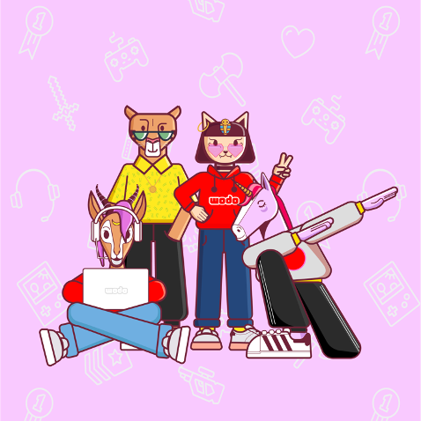
Thank you
Bekir DAG – CEO , bekir@wodo.io
Serhat TANRIKUT – CTO , serhat@wodo.io
+32 470 204 836

